Slide 1
Prepare your project kick-off meeting agenda
Christopher I. Macintosh, PhD, RN
Notes:
Hello everyone
My name is Chris Macintosh. I help teach the capstone courses.
In this video we’ll talk more in-depth about preparing your project kick-off meeting agenda.
[Next slide]

Slide 2
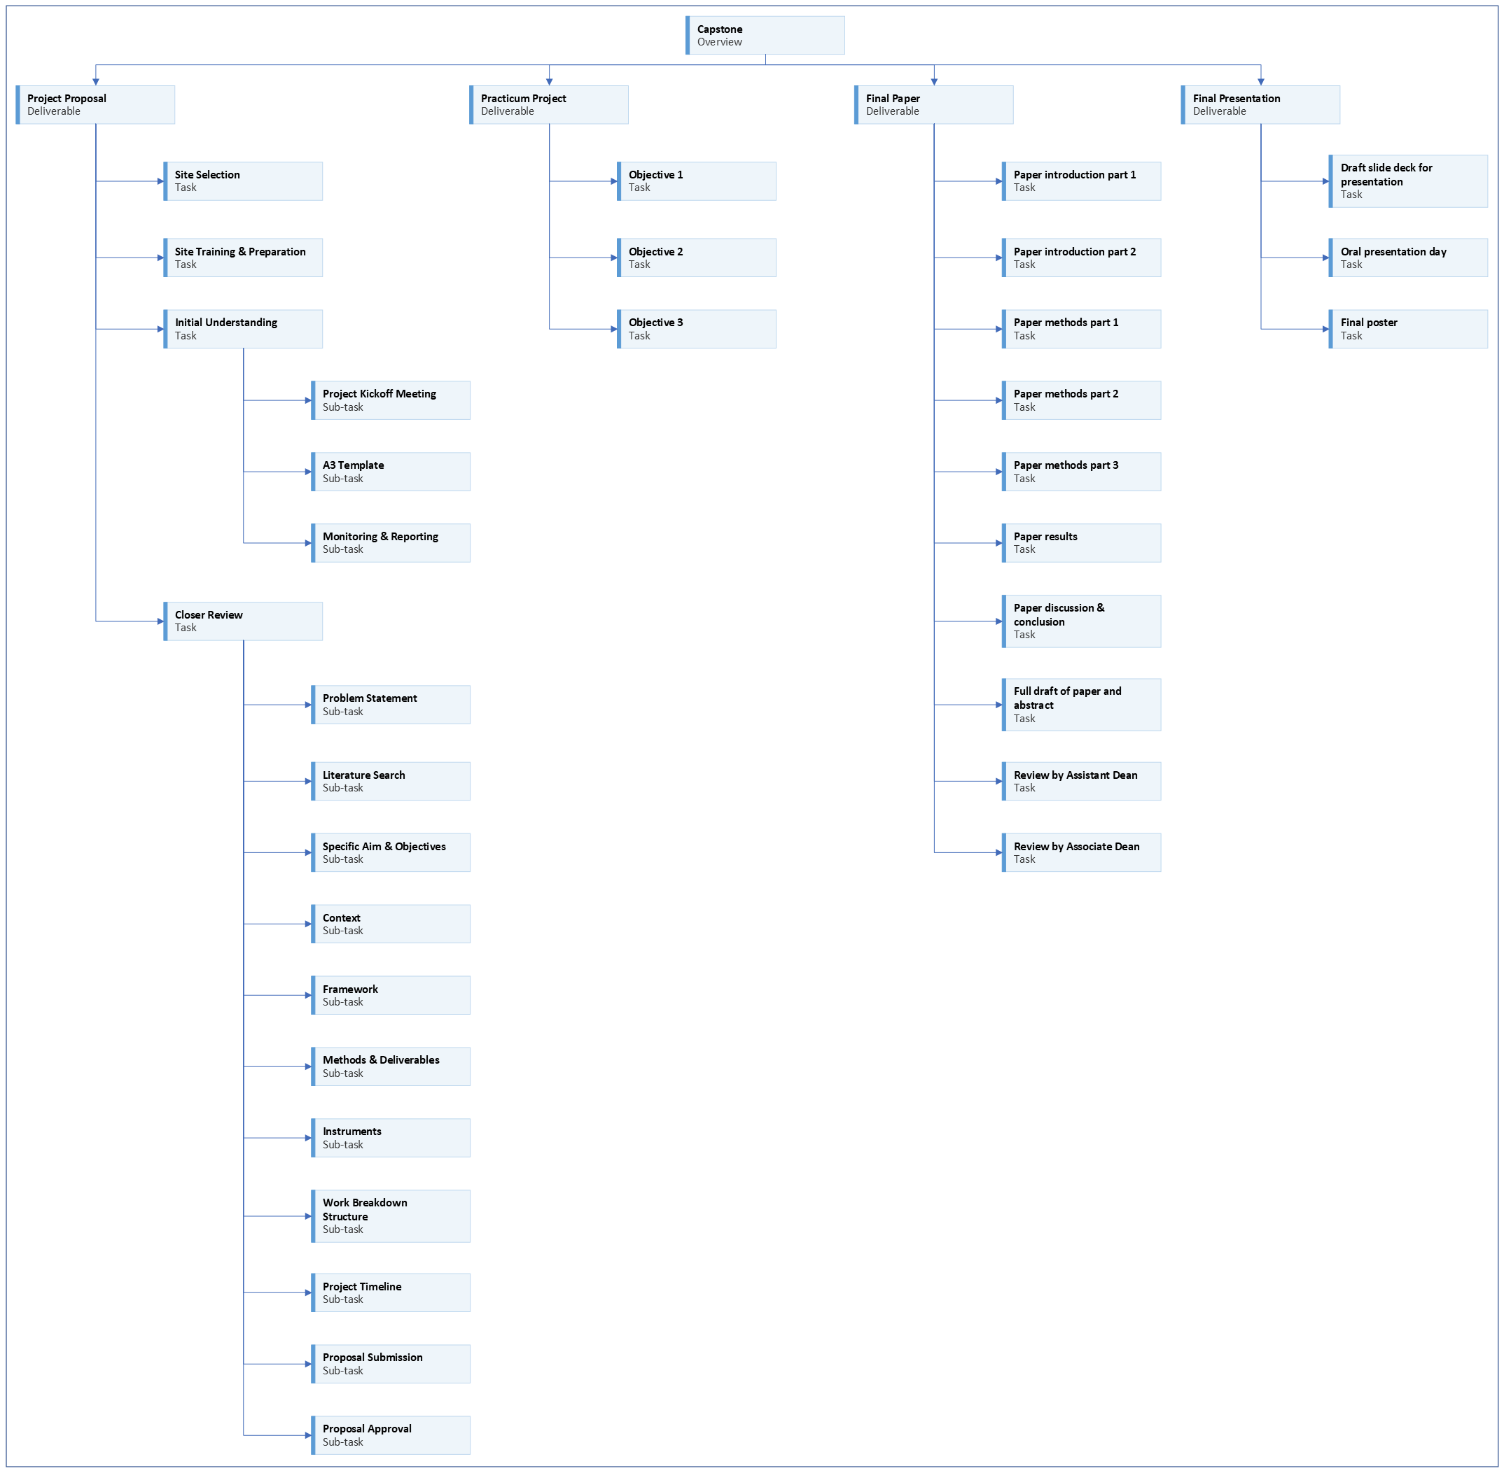
Notes:
This is part of the initial stages of creating our project proposal.
[Next slide]

Slide 3
(Schwalbe, 2021)
Notes:
[click]
As previously mentioned, we need to get an initial understanding of our project.
[click]
You need to set up an initial meeting with your practicum preceptor.
Holding a project kick-off meeting is a great way to get your project off to a good start.
A kick-off meeting is a good way to allow everyone to meet each other, review project goals, and start future planning.
It is also a good place to clarify roles and responsibilities.
[click]
It would be helpful in this initial planning phase, if you can have some kind of structure to help guide you through getting to know important parts of your project, how much has already been planned, and what parts still need to be ironed out.
You should have been introduced to the A3 template in your quality improvement course.
The A3 template is a one-page summary of a quality improvement project.
It is a good tool to use here to get a quick overview of your project and get an idea of what kind of planning still needs to happen.
[Next slide]

Slide 4










the capstone toolkit
Notes:
[click]
You will find sample meeting agendas, including one for the project kick-off meeting in the Capstone Toolkit.
[Next slide]

Slide 5
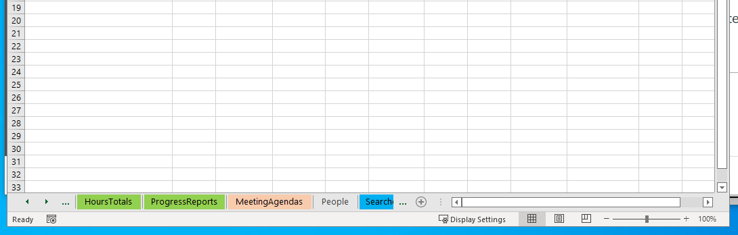
Notes:
[click]
The Capstone Toolkit is an Excel workbook that contains multiple sheets.
Tabs for sheets can be seen along the bottom of the window.
[click]
You can move the visible sheet tabs by clicking the left and right arrows in the bottom left corner of the window.
[click]
Look through the available sheet tabs until you find the desired sheet and click on the tab.
[next slide]

Slide 6
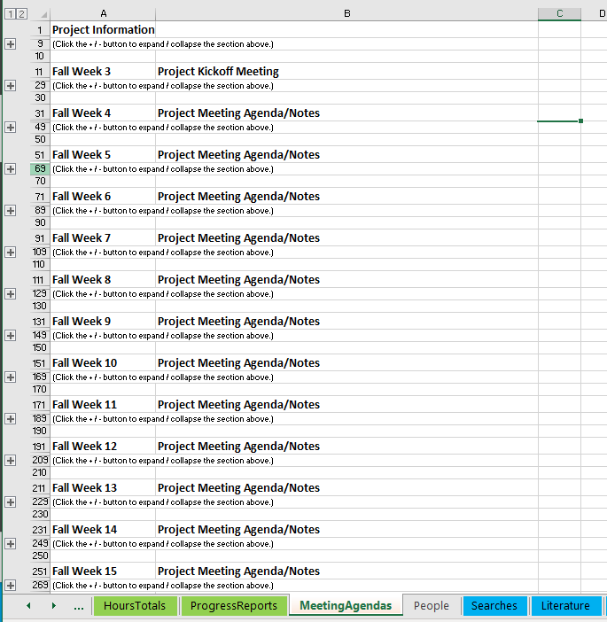
Notes:
The MeetingAgendas sheet has sections for agendas for weekly meetings.
[click]
A section can be expanded by clicking the plus sign in the worksheet margin on the left.
[click]
Expand the section for the Project Kickoff meeting to see the agenda.

Slide 7
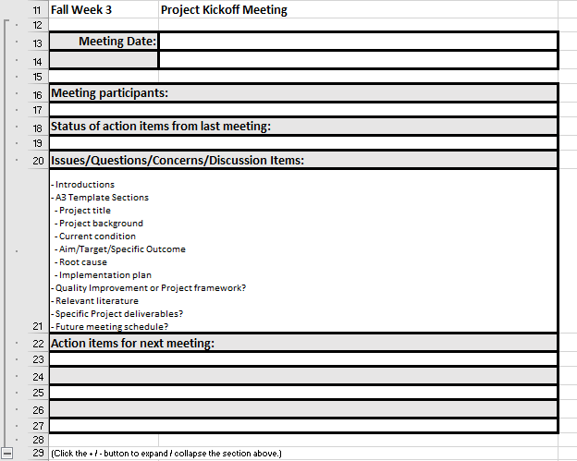
The project kick-off meeting
Notes:
Sample meeting agendas are included in the Capstone Toolkit, including one for the project kick-off meeting. (Shown here.)
Once you are assigned to a project site and preceptor, you should create a proposed agenda.
Review the proposed agenda for the project kickoff meeting. Does it contain the topics you think need to be covered?
Set up a time to meet with your preceptor.
Send the proposed agenda to your project preceptor and see what agenda items they feel are important to discuss.
I recommend setting up a regular meeting time so you can coordinate as needed and make steady progress.
Meeting weekly for 30 minutes is probably a good cadence, but you and your project preceptor can decide what works best for your project.
If no one has anything to report to the group, the meeting can always be cancelled if it’s not needed.
[Next slide]

Slide 8



Prepare for meetings
Notes:
Students should always prepare for every meeting.
[click]
Meeting are expensive for an organization.
The more people attending the meeting, the more expensive it is.
Time spent in meetings is time spent away from other work.
[click]
Your preceptor’s time is valuable. Don’t waste it.
[click]
Being prepared will make a good impression and show you are a professional.
[next slide]

Slide 9
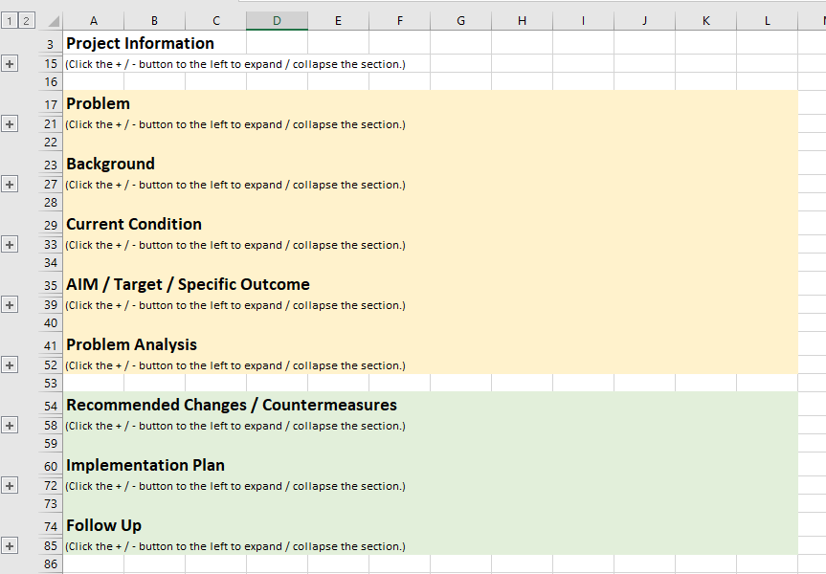
The A3 template
Notes:
I’ve already introduced the A3 template.
If you preceptor has another planning/overview tool, be flexible and learn what it is.
I will love to learn about it.
The A3 template is provided here as an aid to help you get up to speed with your project quickly.
Here are the points about the A3 template I reviewed previously.
The A3 template is a one-page summary of a quality improvement project.
It is divided into two main sections.
The first section focuses on the problem you’re trying to solve.
And the second section focuses on the solution you’re trying to implement.
There are many different A3 templates available on the internet.
There are links to additional information about the A3 template in Canvas.
I have included a version formatted on an Excel worksheet in the Capstone Toolkit.
Individual sections of the A3 template here can be expanded by clicking on the plus signs in the sheet’s left margin.
The sections of the A3 template can help guide you and your practicum preceptor in discussing the key elements of your project.
It may also help you identify gaps in the project plan.
Once a gap in the plan has been identified, you and your project preceptor can work together to create what is still needed.
[Next slide]

Slide 10
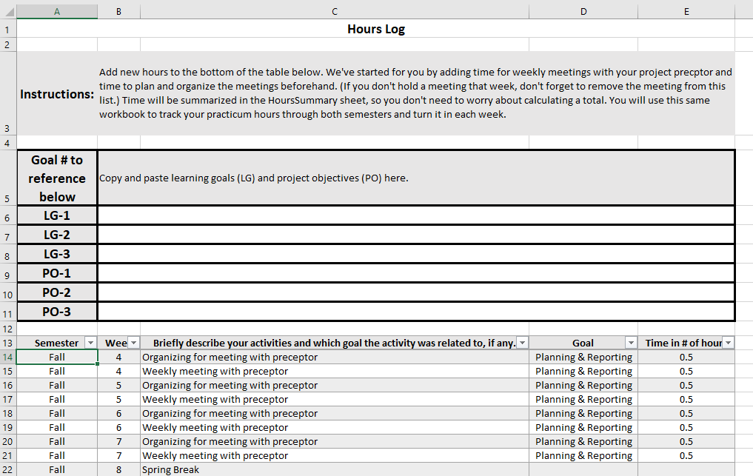

Tracking time
Notes:
Remember to track the time you spend planning, preparing for meetings, and meeting with your preceptor in the HoursLog sheet of your Capstone Toolkit.
[Next slide]

Slide 11



Personal learning goals?
Notes:
This is a good time to think about what you would like to get out of this experience.
[click]
Outside of the project, are there any additional things you would like to learn or get better at?
[click]
The project kickoff meeting might be a good time to also discuss personal learning goals with your preceptor.

Slide 12

training
Notes:
Do you have any additional site training you need to complete to be able to continue with your practicum?

Slide 13

More to come . . .
Notes:
That’s all we’ll do in this video.
There is more to come.
[next slide]

Slide 14
References
Schwalbe, K. (2021). Healthcare project management, third edition: Predictive, agile, and hybrid approaches. Schwalbe Publishing.
Notes:
These are the references.

